Slide 1
NAME:ATUHAIRE PAULINE
REG NO:B35093
COURSE:DATA LIFE CYCLE

Slide 2
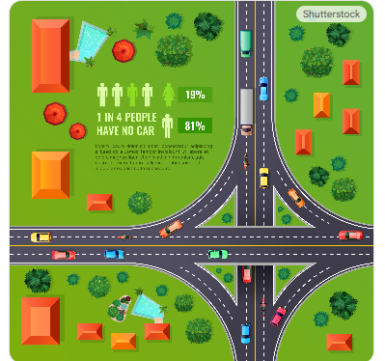
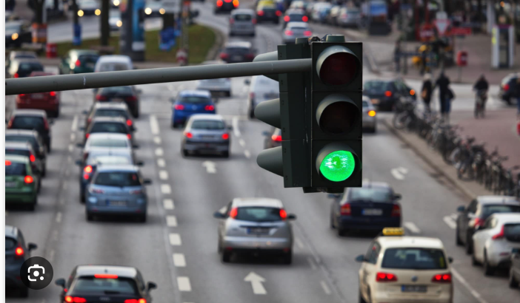
DEEP GREEN
Deep Green: Is an autonomous traffic control system powered by Deep Reinforcement Learning
The Problem(The Why)
Congestion costs billions annually
Current solution: Fixed timers (inefficient) or expensive sensors (hard to maintain).
Goal: An agent that sees traffic and adapts instantly.

Slide 3
Comparison of Rule-Based Control(If X then Y) Vs Trial and Error(Optimal Policy)
Feature | Rule-Based Control | RL Control
Knowledge Source | Human expertise, explicit rules | Data from interaction, trial & error
Adaptability | Low; rules must be manually updated for new situations | High; learns and adapts to changing environments over time
Complexity | Suitable for simple, well-defined problems | Suitable for complex, dynamic problems where rules are hard to define
Decision Process | Follows deterministic "If X then Y" logic | Learns a "policy" that maximizes long-term reward

Slide 4
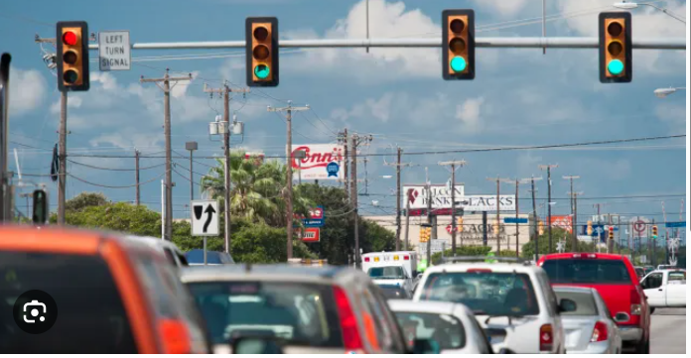
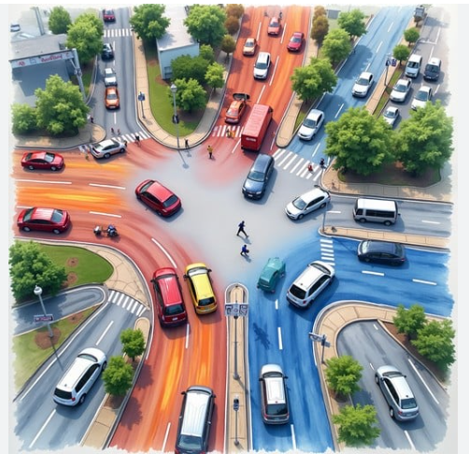
Illustration of Rule-Based Control(If X then Y) Vs Trial and Error(Optimal Policy)
Traditional coding requires us to write rules for every possible traffic scenario. RL allows the agent to learn the rules by interacting with the traffic itself, finding optimizations humans might miss

Slide 6
The Solution: Deep Q-Network (DQN)
Key Concepts:
Experience Replay: Remembering past traffic jams to learn from them later.
Exploration: Occasionally trying random phases to discover new strategies.

